Slide 1
FREEDOM OF SPEECH

Slide 2
PROBLEM 1:
INTENTION VS RECEPTION
OF MESSAGES
Example: Tom and Sheila are married. They are in a car. Tom is at the wheel. They stopped at a red light. Suddenly the light turns green. Sheila says: “The traffic light is green.”
What does Sheila intend with her message?
How does Tom receive this message?

Slide 3
Sheila: “The traffic light is green.”
Receiver’s perspective
4 sides to the message // Schulz von Thun’s model
1) Factual level => Information => She simply informs Tom.
2) Appeal level => Desire => She wants Tom to hurry.
3) Relational level => Relationship => She feels Tom is a bad driver.
4) Self-revelation => Feelings => She is in a hurry or annoyed.
Which side(s) of the message(s) will Tom receive?
Can Sheila control that? (Tone?)

Slide 4
EXAMPLE: THEO
Theo is a 16-year-old black American teenager.
His great grandfather John was a slave.
He was tortured to death by white slave owners.
His grandfather William was a preacher.
White people burned down William’s church.
Theo’s father told Theo about all this and the struggle of black people.
Theo’s cousin got racially abused by white policeman.
Billy is white student who is Theo’s classmate.

Slide 5
How do you think Theo will receive the following message?
Billy: “Shut up you damn n*%&£!”
1) Factual level => Information => Billy wants Theo to be quiet.
2) Appeal level => Desire => B. doesn’t want T. to speak.
3) Relational level => Relationship => B. feels superior to T.
4) Self-revelation => Feelings => B hates black people.
Which side(s) of the message(s) will Theo receive?
Keep Theo’s background in mind.
Can Billy’s sentence ever be innocent? Playful? A joke?
So how important is “CONTEXT” in this case?

Slide 6
PROBLEMS // FREEDOM OF SPEECH
Can you be held responsible for the intention of your message?
This seems to be under your control.
Can you be held responsible for the reception of your message?
This seems to be out of your control.
What if the intention of the message matches the reception?
If you intend to offend and people are offended, who is responsible?

Slide 7
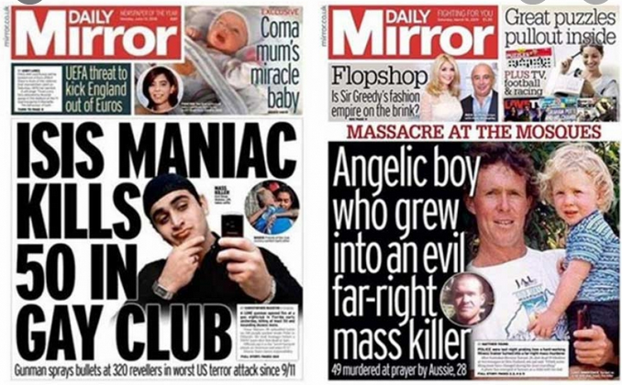
BIAS - BEFANGENHEIT

Slide 8
FREEDOM OF SPEECH
Definition:
The power or right to express one's opinions without censorship, restraint, or legal penalty.
Famous quote:
“I disapprove of what you say, but I will defend to the death your right to say it.”
Evelyn Beatrice Hall – taken from The Friends of Voltaire

Slide 9
Charlie Hebdo – Terror Attack
FACT: Indefensible and horrible act of violence by 2 people.
AFTERMATH / COMMON STANCE AMONG PEOPLE:
The terror attack was an attack on the precious values of the west.
These values include: freedom of speech and freedom of the press.
Charlie Hebdo has the right to ridicule the Prophet Muhammad.
Regardless of anyone’s feelings. Anything else would be censorship.
Censorship is only part of lesser civilizations and dictatorships.
We live in a democracy. We hold our freedom of speech sacred.
Je suis Charlie! Vive Charlie Hebdo! I am for freedom of speech.

Slide 10
PROBLEM: HIPOCRISY / DOUBLE STANDARDS
We love freedom of speech when it suits us / the west:
morally – politically – personally – financially
AGENDA
But if we were to put our own romantic perception of freedom of speech to the test, I think we would realise that we are hypocrites.
So it’s morally difficult to be part of a camp that celebrates freedom of speech only when it is useful, and labels it something else or ignores it when it’s not useful.

Slide 11
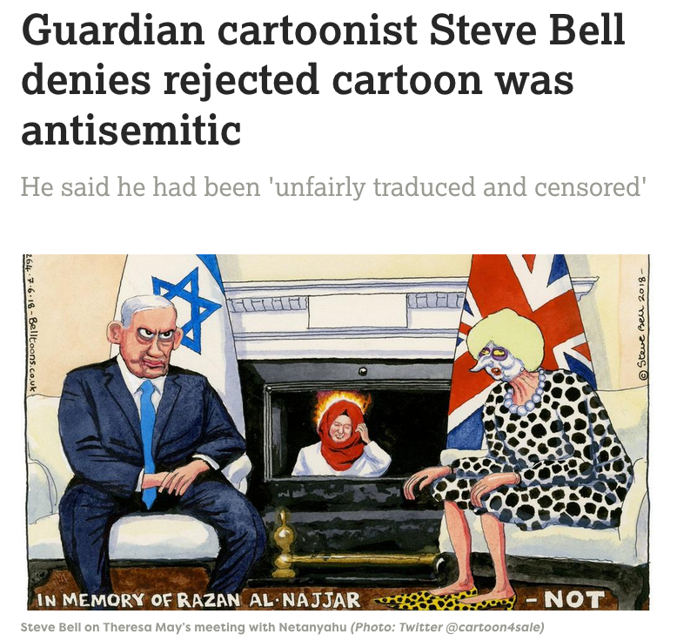

Slide 12
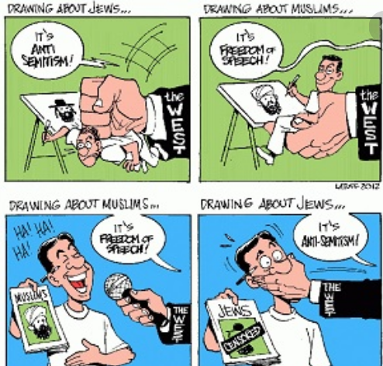
IT DEPENDS ON WHOSE SYMBOLS YOU MOCK!

Slide 13
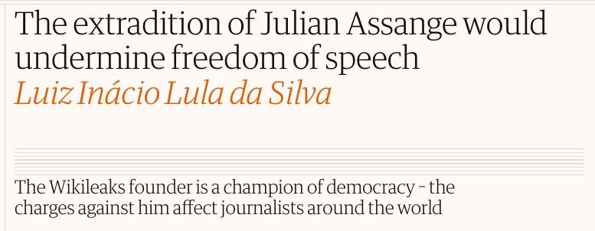
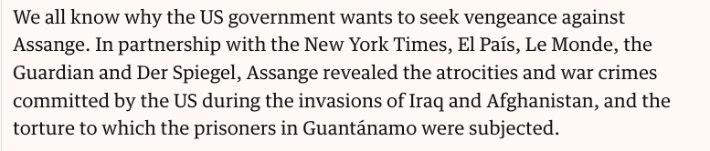
EXAMPLE
THE GUARDIAN

Slide 14
SO THINGS ARE NOT BLACK AND WHITE
IT’S COMPLICATED
- Perhaps both types of cartoons are bad taste and should not be printed?
- Can I dislike Charlie Hebdo and still be for freedom of speech?
- Where does hate speech start and freedom of speech begin?
- “Incitation à la haine” VS free speech
national security / espionage VS freedom of press
Should we make NAZI parties illegal or is that censorship?
What about social responsibility?

Slide 15
EUROCENTRISM / ORIENTALISM
Eurocentrism:
Europeans believe they are the norm in terms of culture, religion, standards, society. Everything that’s different is suspicious, inferior, laughable, not valuable…
Orientalism:
Stigmatising people from the Orient as barbarians, savages and terrorists with crazy beliefs. Depicting their societies as medieval and cruel.

Slide 16
DOUBLE STANDARDS // POLITICS
https://www.youtube.com/watch?v=qsFWFP6bCbQ

Slide 17
Russian Army to Test Coronavirus Vaccine on Troops

Slide 18
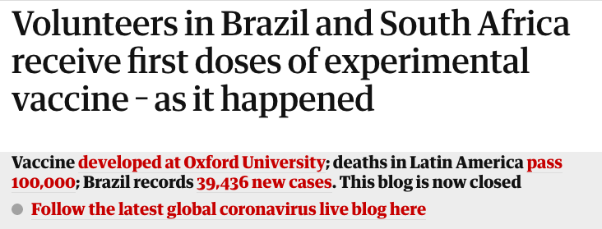

Slide 19
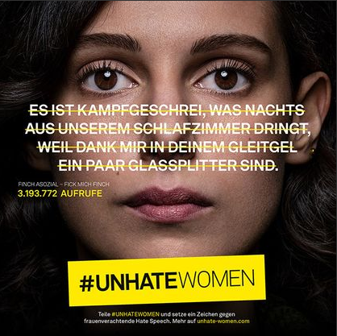
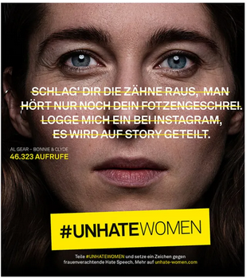
THANK GOD WE HAVE FREEDOM OF SPEECH

Slide 20
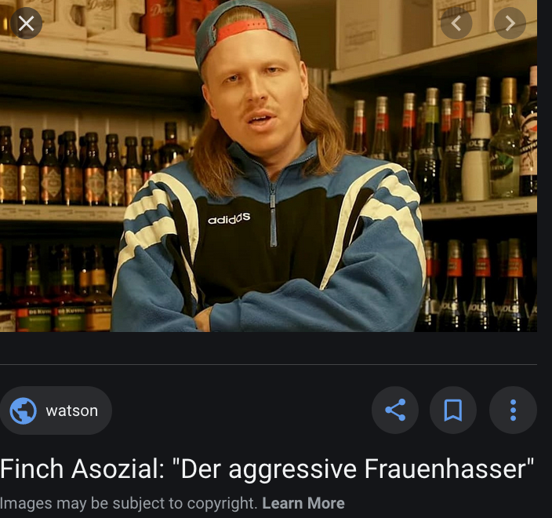

Slide 21
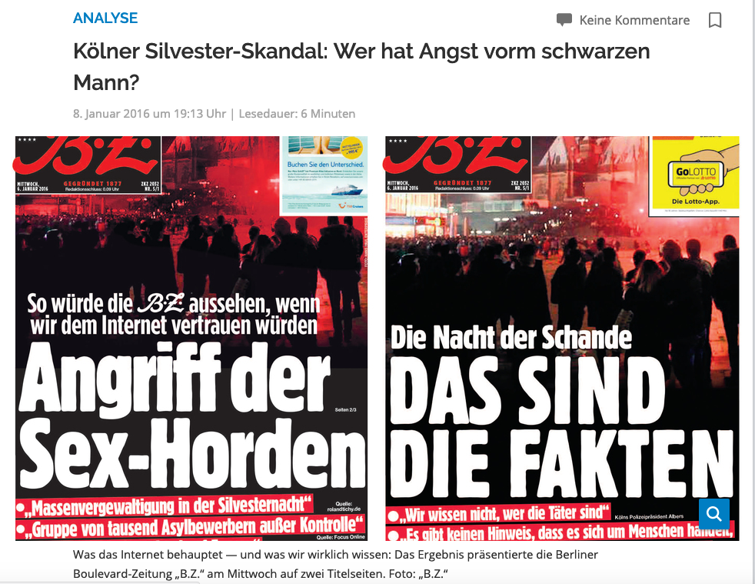

Slide 22
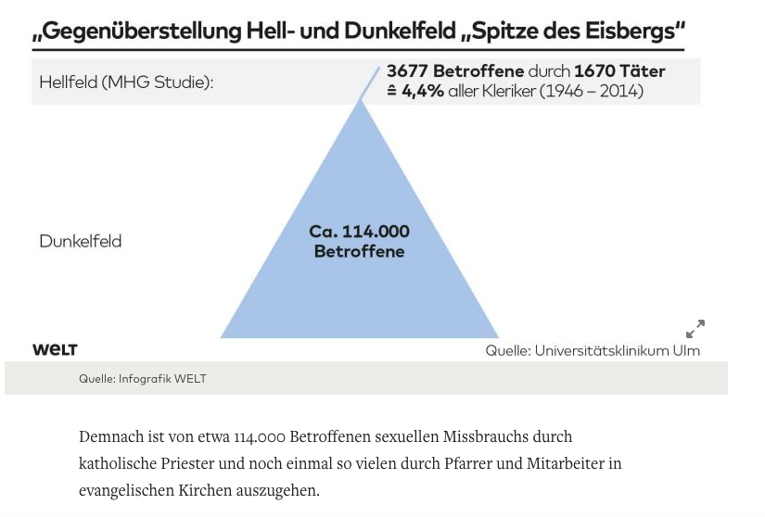

Slide 23
- SHOULD WE COMPARE TRAGEDIES?
- CAN WE COMPARE TRAGEDIES?
- FACT CHECKS?
- TO WHAT END?
- WHAT DOES THIS POST SUGGEST?
- WHAT IS THE AGENDA?
- DOUBLE STANDARDS?
- HIPOCRISY?

Slide 24
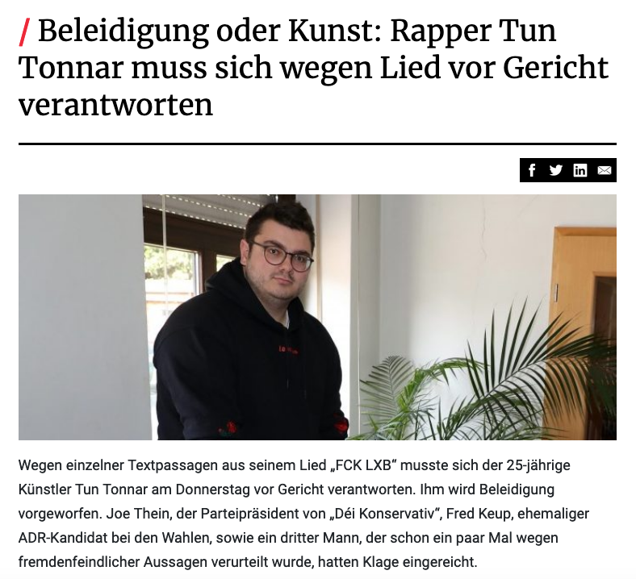

Slide 25
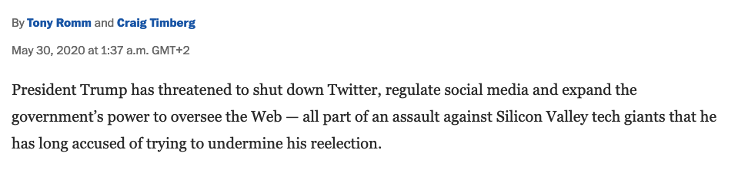
FREEDOM OF SPEECH AND THE TRUTH
If the press is good, freedom of speech is important.
If the press is bad, censorship is necessary.
“Lügenpresse”
the joker against all arguments

Slide 26
