Slide 1
PICTURES
THAT
LIE

Slide 2
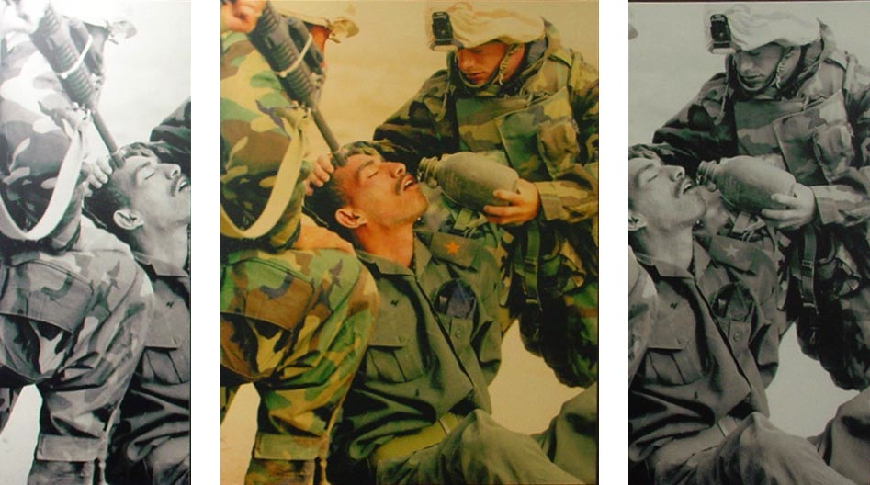
OBJECTIVE VS SUBJECTIVE (March 2003 / WAR IN IRAQ)
Picture A Picture B Picture C
Choose a headline for each picture
Who can benefit from this manipulation?

Slide 3
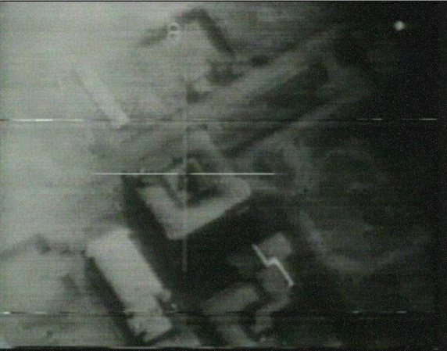
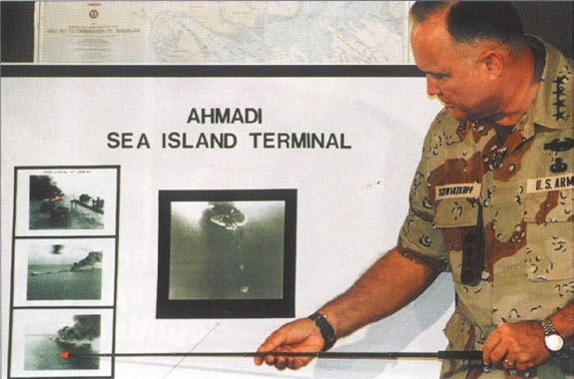
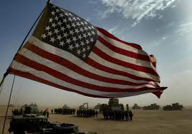
PICTURES OF WAR (1991 / IRAQ / PRESS CONFERENCE )
What impression of the war do these pictures give you?
Why?

Slide 4
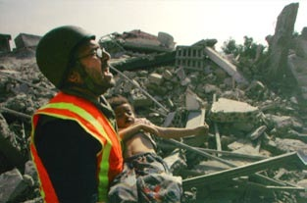
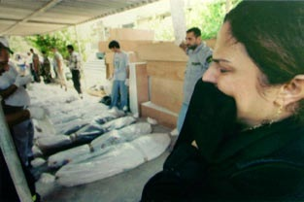
PICTURES OF WAR (SUMMER 2006 / LEBANON)
What impression of the war do these pictures give you?
Why?

Slide 5
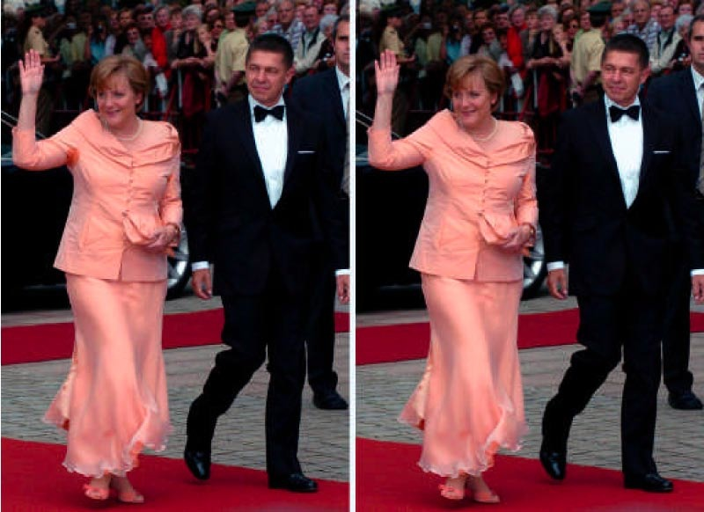
SENDING A MESSAGE
Why did the newspaper feel the need to tamper with the original photograph?

Slide 6
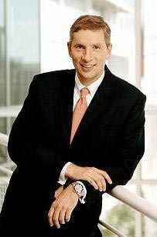
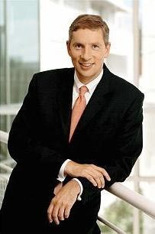
SENDING A MESSAGE / THE CEO OF SIEMENS
ORIGINAL MODIFIED VERSION
Why did Siemens decide to release the modified version?

Slide 7
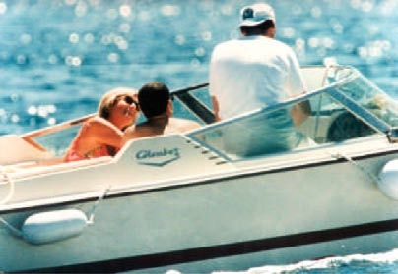
SENDING A MESSAGE / LADY DI / THE YELLOW PRESS
ORIGINAL

Slide 8
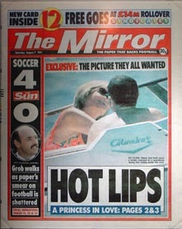
SENDING A MESSAGE / THE YELLOW PRESS
The Mirror Cover
Explain the reasons for this manipulation?

Slide 9
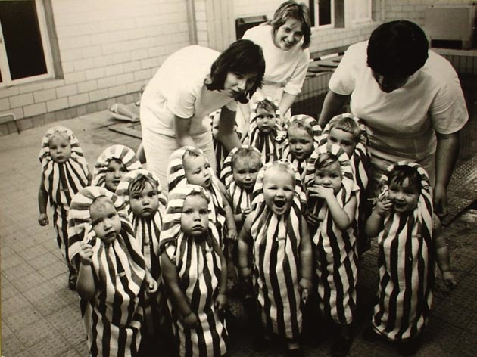
PROPAGANDA / CONTEXT
Describe this picture. What do you see?

Slide 10
PROPAGANDA / CONTEXT
The picture was taken in a daycare facility for children in Leipzig in 1976.

Slide 11

PROPAGANDA / CONTEXT
In this brochure, the picture
has been tampered with.
Inside the brochure you
can read the following
text below the picture:
“Kinder in Häftlings-
kleidung. Ein aus einem
Sowjet-KZ in der UdSSR
geschmuggeltes Bild.
Die Kinder wurden in einem
Häftlingslager geboren und
wachsen dort auf, bis die
Eltern einmal entlassen
werden.”
Explain the reason for this
manipulation!

Slide 12
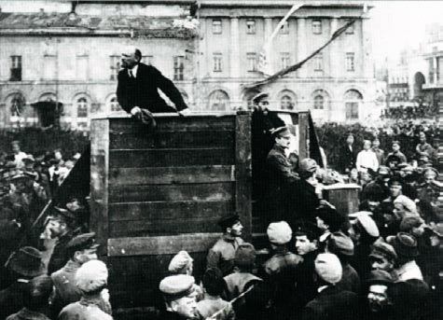
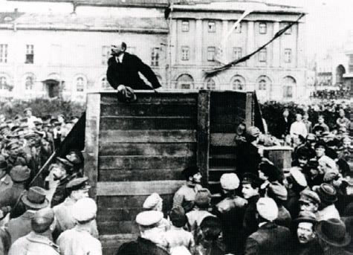
PROPAGANDA / CONTEXT / 1920 / Trotsky / Kamenew
before Stalin took power after Stalin took power

Slide 13
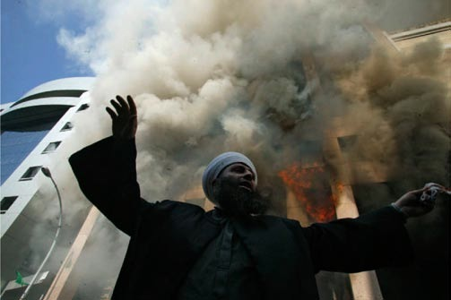
CARTOONS OF MUHAMMAD
In 2005, cartoons of Mohammad were printed in a Danish newspaper.
In some parts of the world, violent demonstrations broke out.
The following picture shows a Libanese priest in front of the burning Danish
consulate.

Slide 14
RESPONSIBILITY OF THE MEDIA
The news agency AFP used the following text with the picture:
“Ein islamischer Geistlicher versucht die Menge zu beschwichtigen.”

Slide 15
RESPONSIBILITY OF THE MEDIA
The German magazine “Stern” used the following text with the picture:
“Ein Geistlicher heizt die Stimmung aufgebrachter Gläubiger in der libanesischen Hauptstadt an.”

Slide 16
RESPONSIBILITY OF THE MEDIA
Explain the reasons for this manipulation!

Slide 17
2 METHODS
1) Tampering with the original picture
2) Changing the context of a picture

Slide 18
QUOTES
“History is written by its victors.”
Walter Benjamin
“Whoever controls the images, controls the spirits.”
Bill Gates
“The first casualty of war is truth.”
Rudyard Kipling

